Slide 1
HDR Imaging
Surya Poddutoori

Slide 2
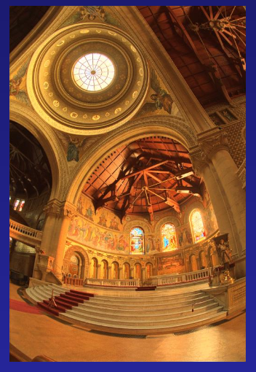
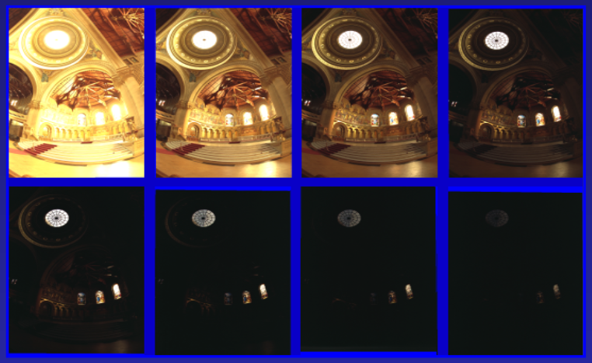
Method & Motivation
Take LDR images from different exposures to create an HDR Image.
Felt like this would be something that I could in the future do with my own set of images.

Slide 3
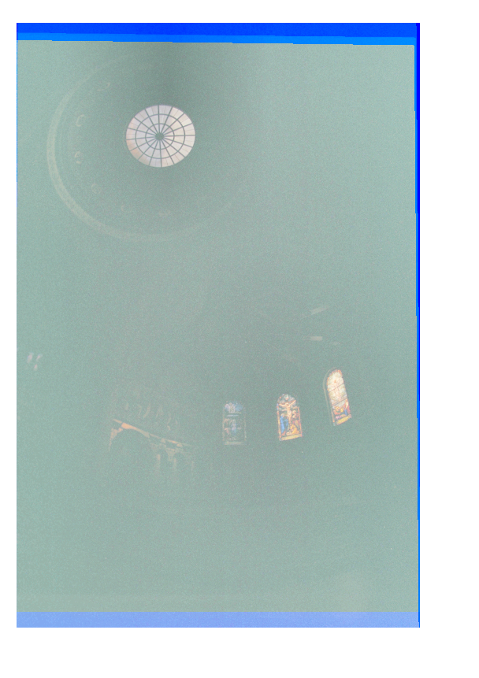
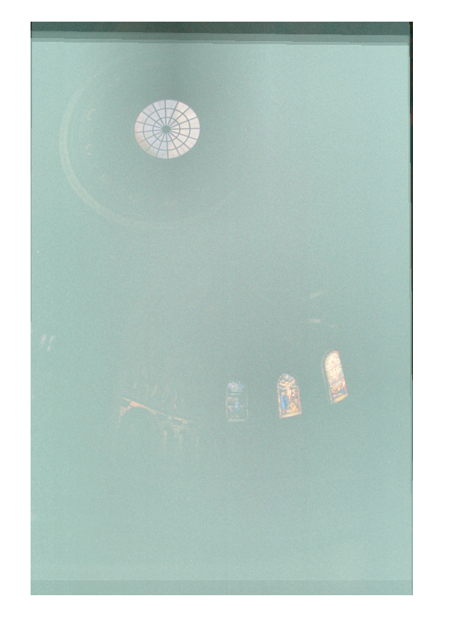
Naive Approaches
Simple averaging and weighted averaging ended up removing more detail than given.
Simple Average
Weighted Average

Slide 4
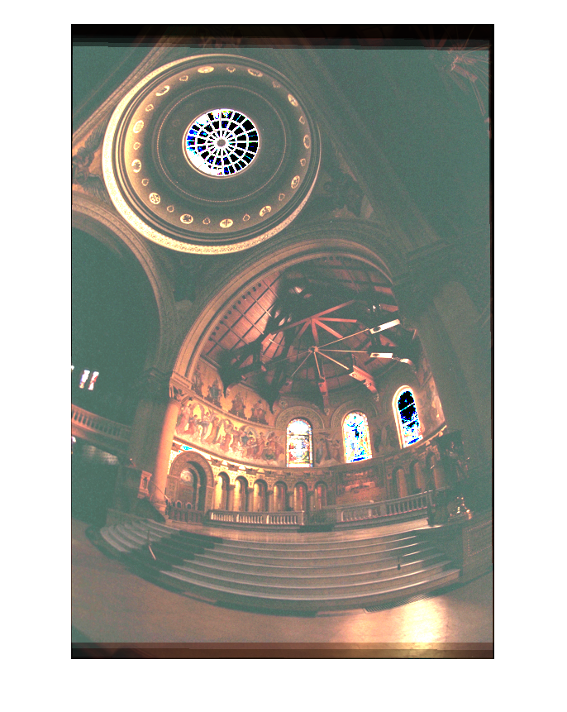
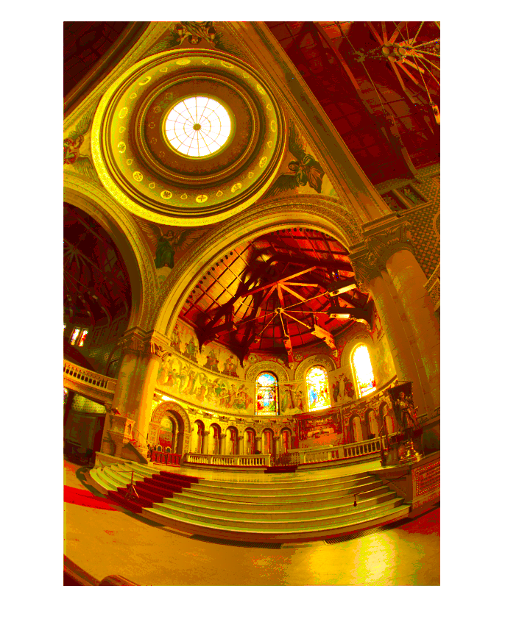
Naive Approaches
Median and Highest Non-Saturating appeared much more promising.
Median Exposure
Highest Non-saturating @85%

Slide 5
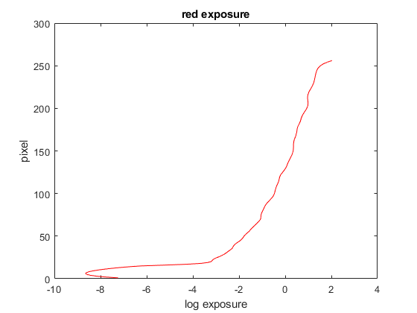
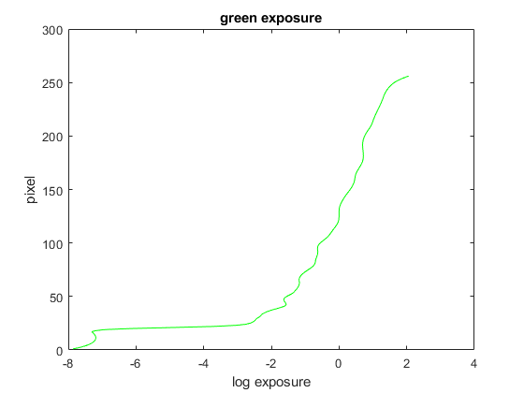
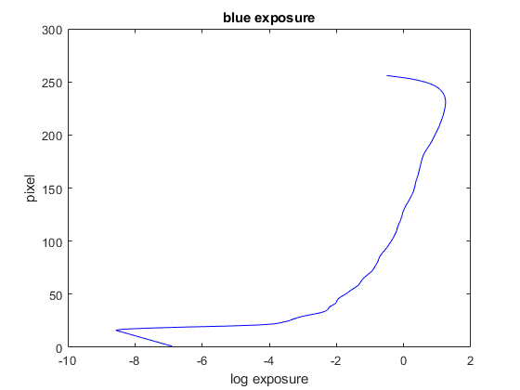
Response Function Approach
Solved for g(Z) = ln(R*t) = ln(R)+ln(t) with 100 pixels from each exposure.
Lambda of 31.

Slide 6
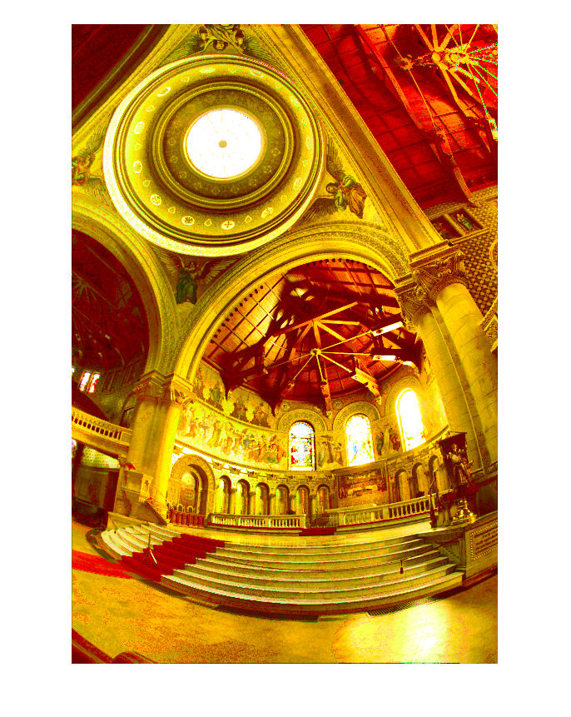
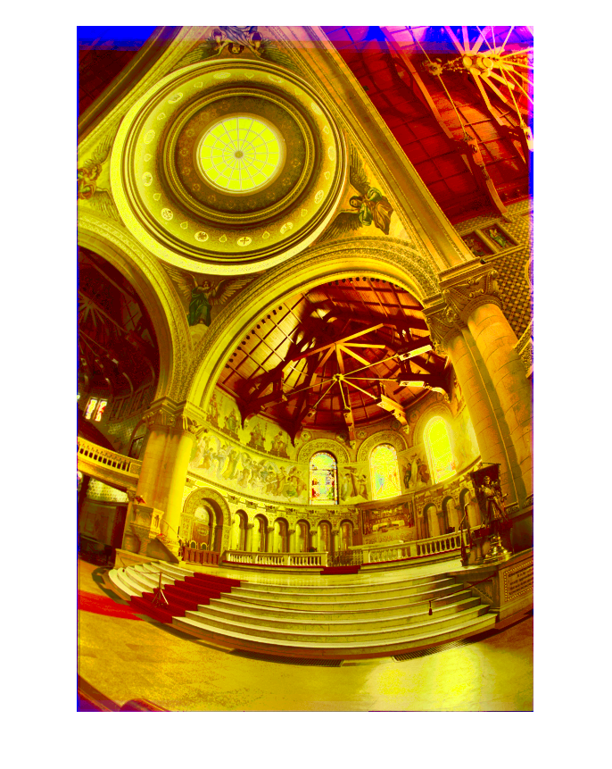
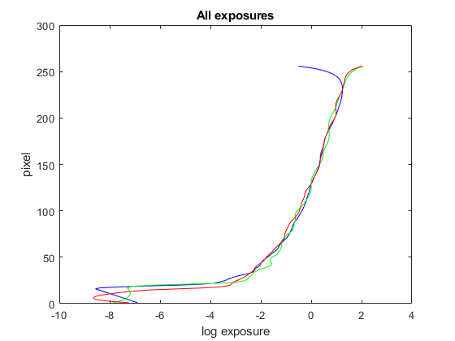
Response Function Approach
Better detail in some parts but overexposed in others.
Non Saturating HDR
HDR

Slide 7
Difficulties & Potential Solutions
Further tweak the response function application.
Test different setting, with different set of exposures.
Add glare and other particle effects to make image appear more realistic.

